Slide 1
NETW191 Course Project Module 2 IPv4 Addressing

Slide 2
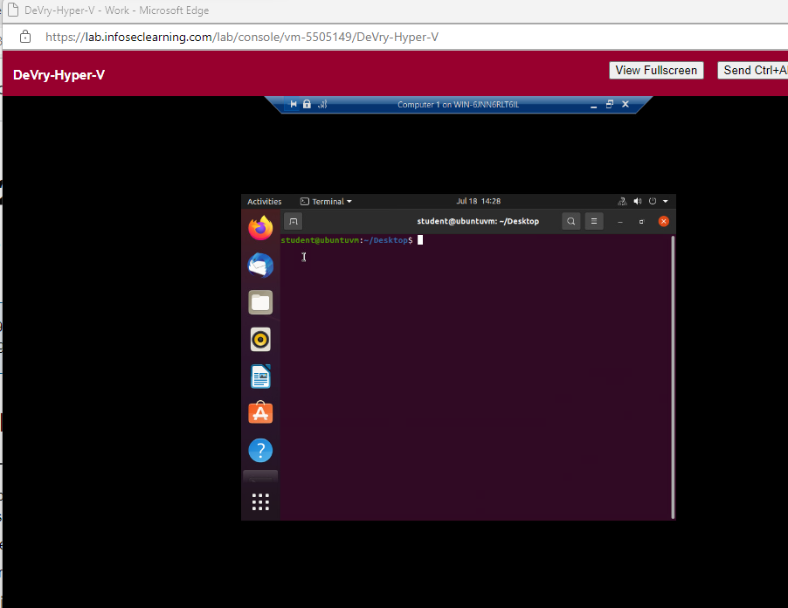
Preparation
This screenshot should include the terminal window that shows the default gateway IP address.

Slide 3
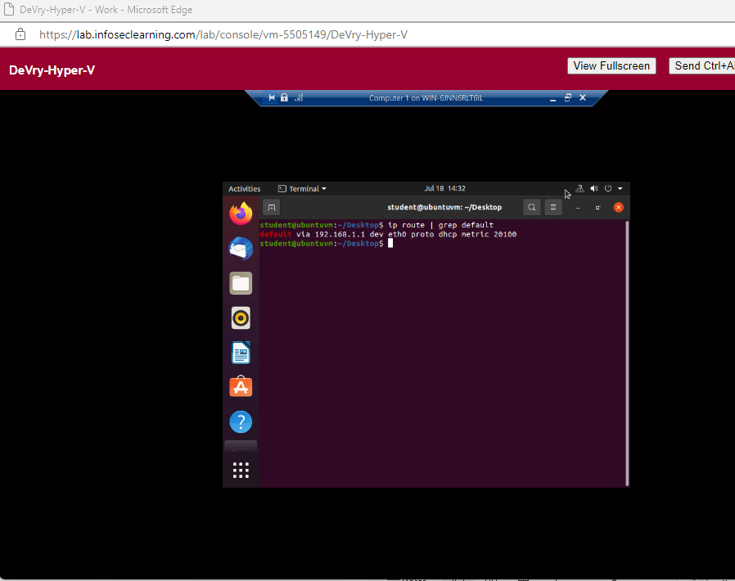
IPv4 Address Assignment
This screenshot should include the Interfaces page that shows the new IPv4 address on the LAN interface.

